Slide 1
Stock Price Prediction
Capstone Project 2
Made by – Prachi Chavan

Slide 2

Introduction
1
This Photo by Unknown Author is licensed under CC BY-SA

Slide 3

A stock market prediction is an attempt to forecast the future value of an individual stock, a particular sector or the market, or the market as a whole. These forecasts generally use fundamental analysis of a company or economy, or technical analysis of charts, or a combination of the two.

Slide 4

Aim :
2

Slide 5





This project focuses on the analysis and prediction of stock data for major tech companies using the stock prices of Apple (AAPL), Google (GOOG), Microsoft (MSFT), Amazon (AMZN), and Tesla (TSLA). The data used us the historical stock information of each stock, various metrics, and advanced machine learning techniques. This project aims to provide valuable insights for investors.

Slide 6

Project Structure
3

Slide 7
The project is structured into several key sections, each addressing specific aspects of stock analysis:
1. Data Collection:
Utilize the Yahoo Finance API to fetch historical stock data for the selected companies.
2. Data Analysis and Visualization:
Conduct exploratory data analysis (EDA) to understand stock characteristics.
Visualize key metrics, trends, and relationships using matplotlib and seaborn.

Slide 8
3. Moving Averages and Technical Indicators:
Calculate and visualize moving averages (10, 20, and 50 days) to identify trends.
Compute the Relative Strength Index (RSI) to gauge overbought or oversold conditions
4. Risk Assessment:
Evaluate the risk associated with each stock using historical volatility metrics.
Generate scatter plots to visualize the risk-return trade-off.
5. Stock Price Prediction using LSTM and Simple RNN:
Implement an LSTM neural network and Simple RNN for predicting the future closing price of Tesla (TSLA).
Fine-tune hyperparameters and to assess the model's performance.

Slide 9

About
4

Slide 10
Data :
The stock data of certain tech companies(AAPL,MSFT,AMZN,TSLA,GOOG) is collected from the internet using the yahoo finance module.
The yfinance is one of the famous modules in Python, which is used to collect online data, and with it, we can collect the financial data of Yahoo
.These are the variables in the DataFrame.
Open
High
Low
Close
Adj Close
Volume
company_name

Slide 11

Data Visualization
5

Slide 12
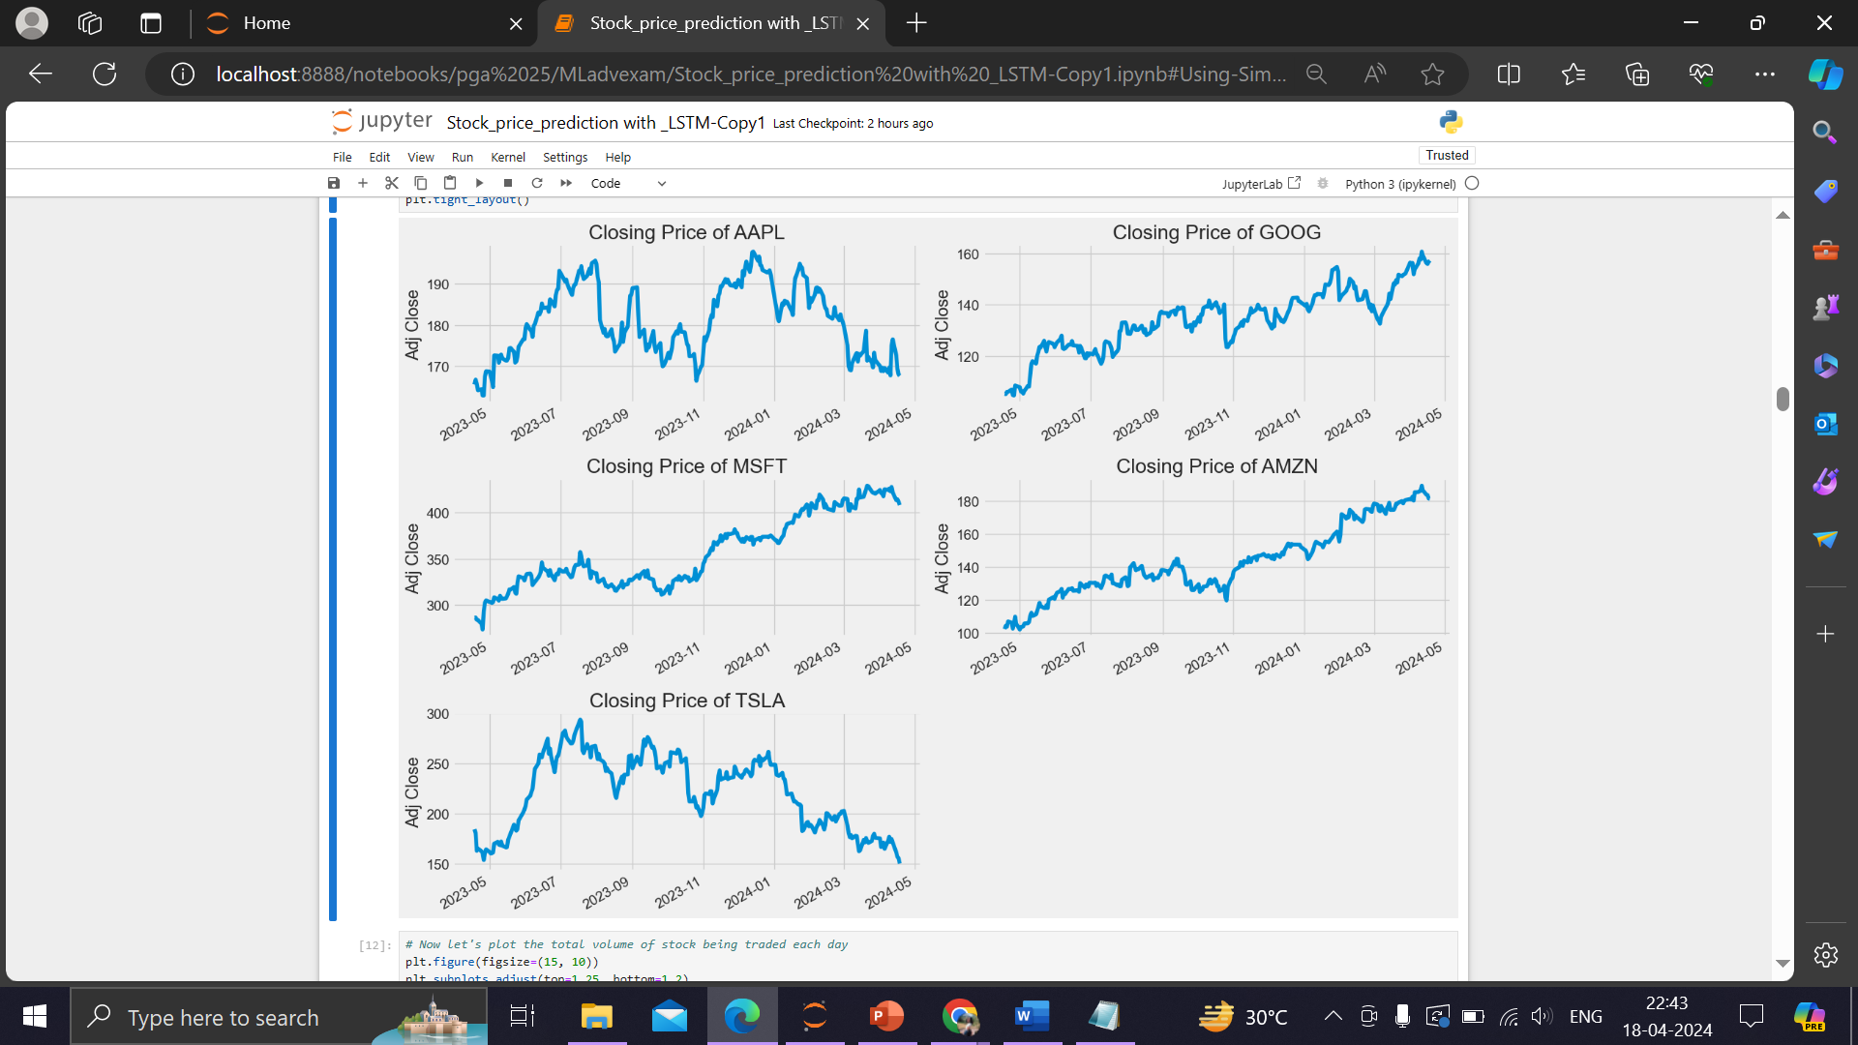
Closing price of each stock

Slide 13
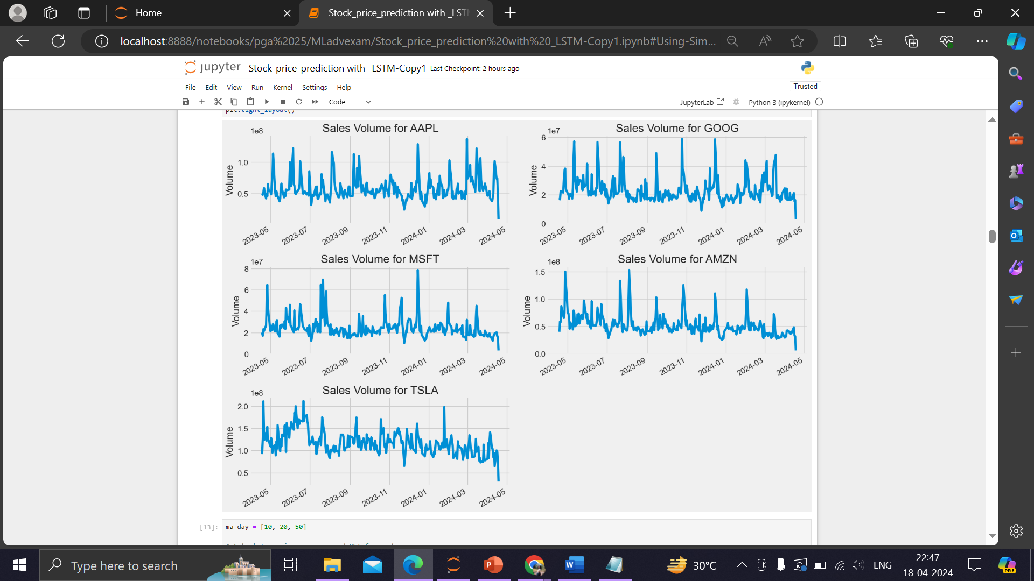
Sales volume for each stock

Slide 14
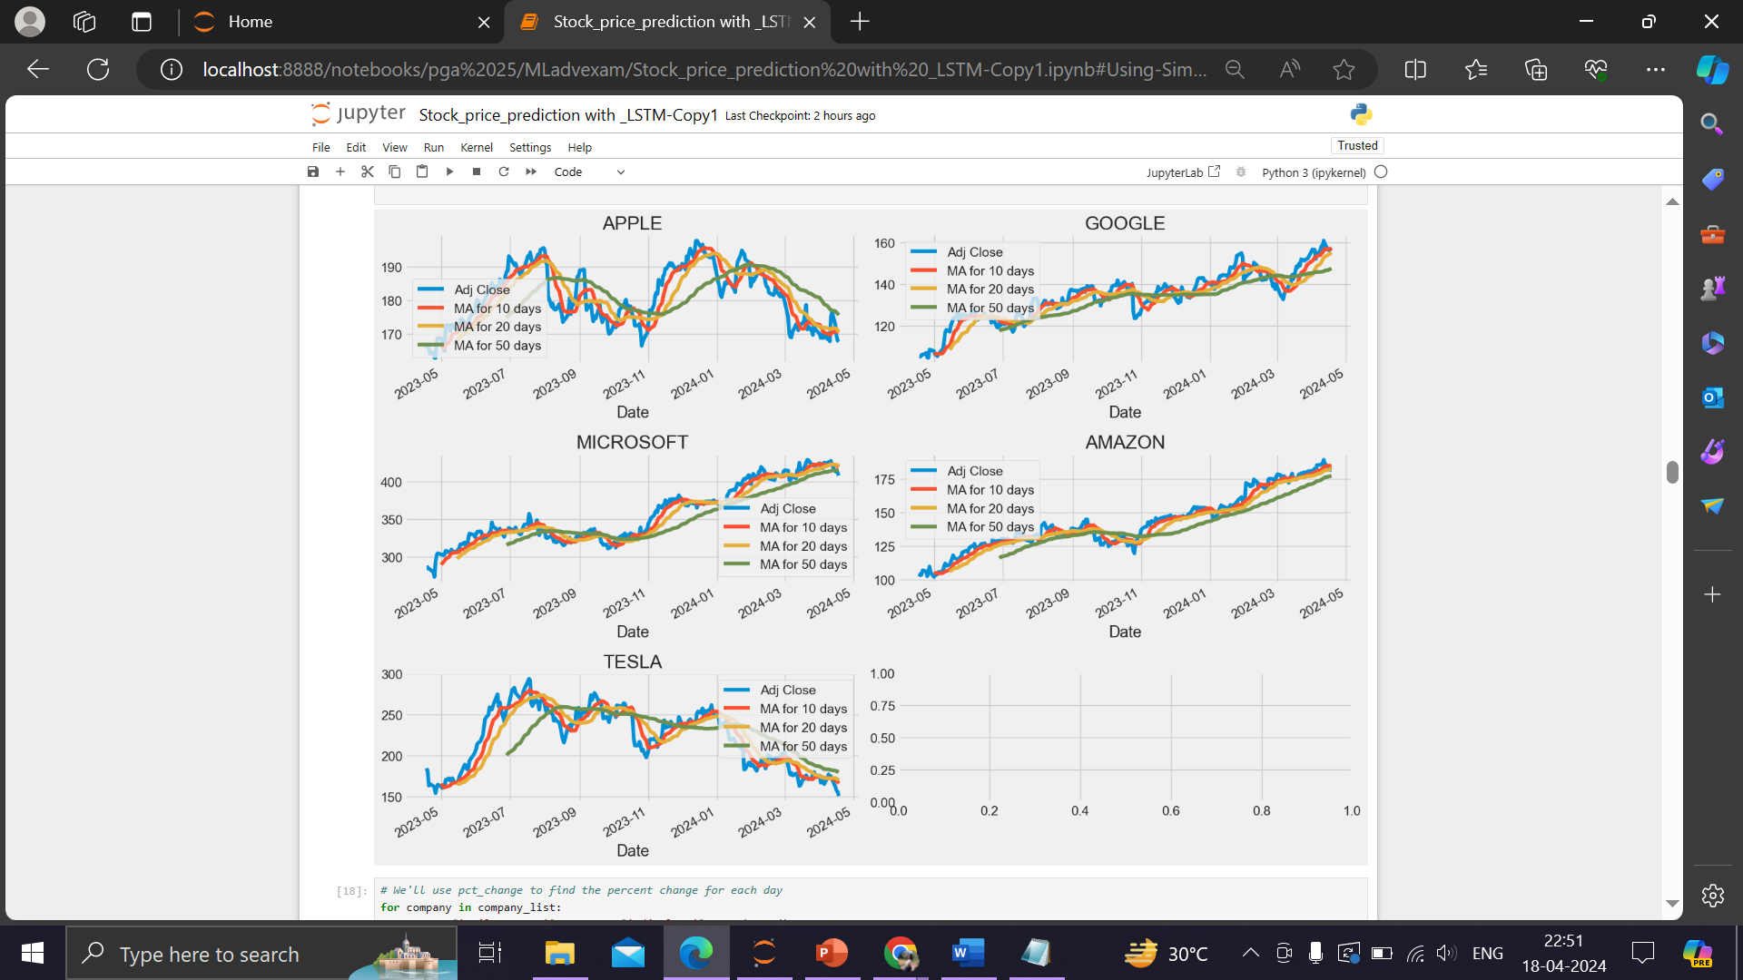
Stock Analysis

Slide 15
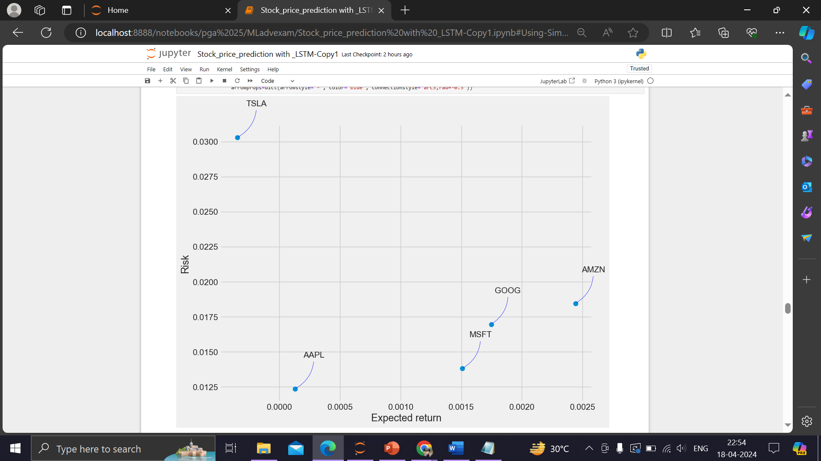
Risk by Expected Return

Slide 16

Building the model
8

Slide 17
Simple RNN
LSTM
model = Sequential()
model.add(SimpleRNN(128, return_sequences=True, input_shape=(x_train.shape[1], 1), activation='relu’))
model.add(Dropout(0.2))
model.add(SimpleRNN(64,return_sequences=False, activation='relu’))
model.add(Dropout(0.2))
model.add(Dense(25, activation='relu’))
model.add(Dense(1))
model.compile(optimizer='adam', loss='mean_squared_error’)
RMSE : 11.953407775984201
model = Sequential()
model.add(LSTM(128,
return_sequences=True, input_shape=(x_train.shape[1], 1), activation='relu’))
model.add(Dropout(0.2))
model.add(LSTM(64,return_sequences=False, activation='relu’))
model.add(Dropout(0.2))
model.add(Dense(25, activation='relu’))
model.add(Dense(1))
model.compile(optimizer='adam', loss='mean_squared_error’)
RMSE : 11.457054280916571

Slide 18
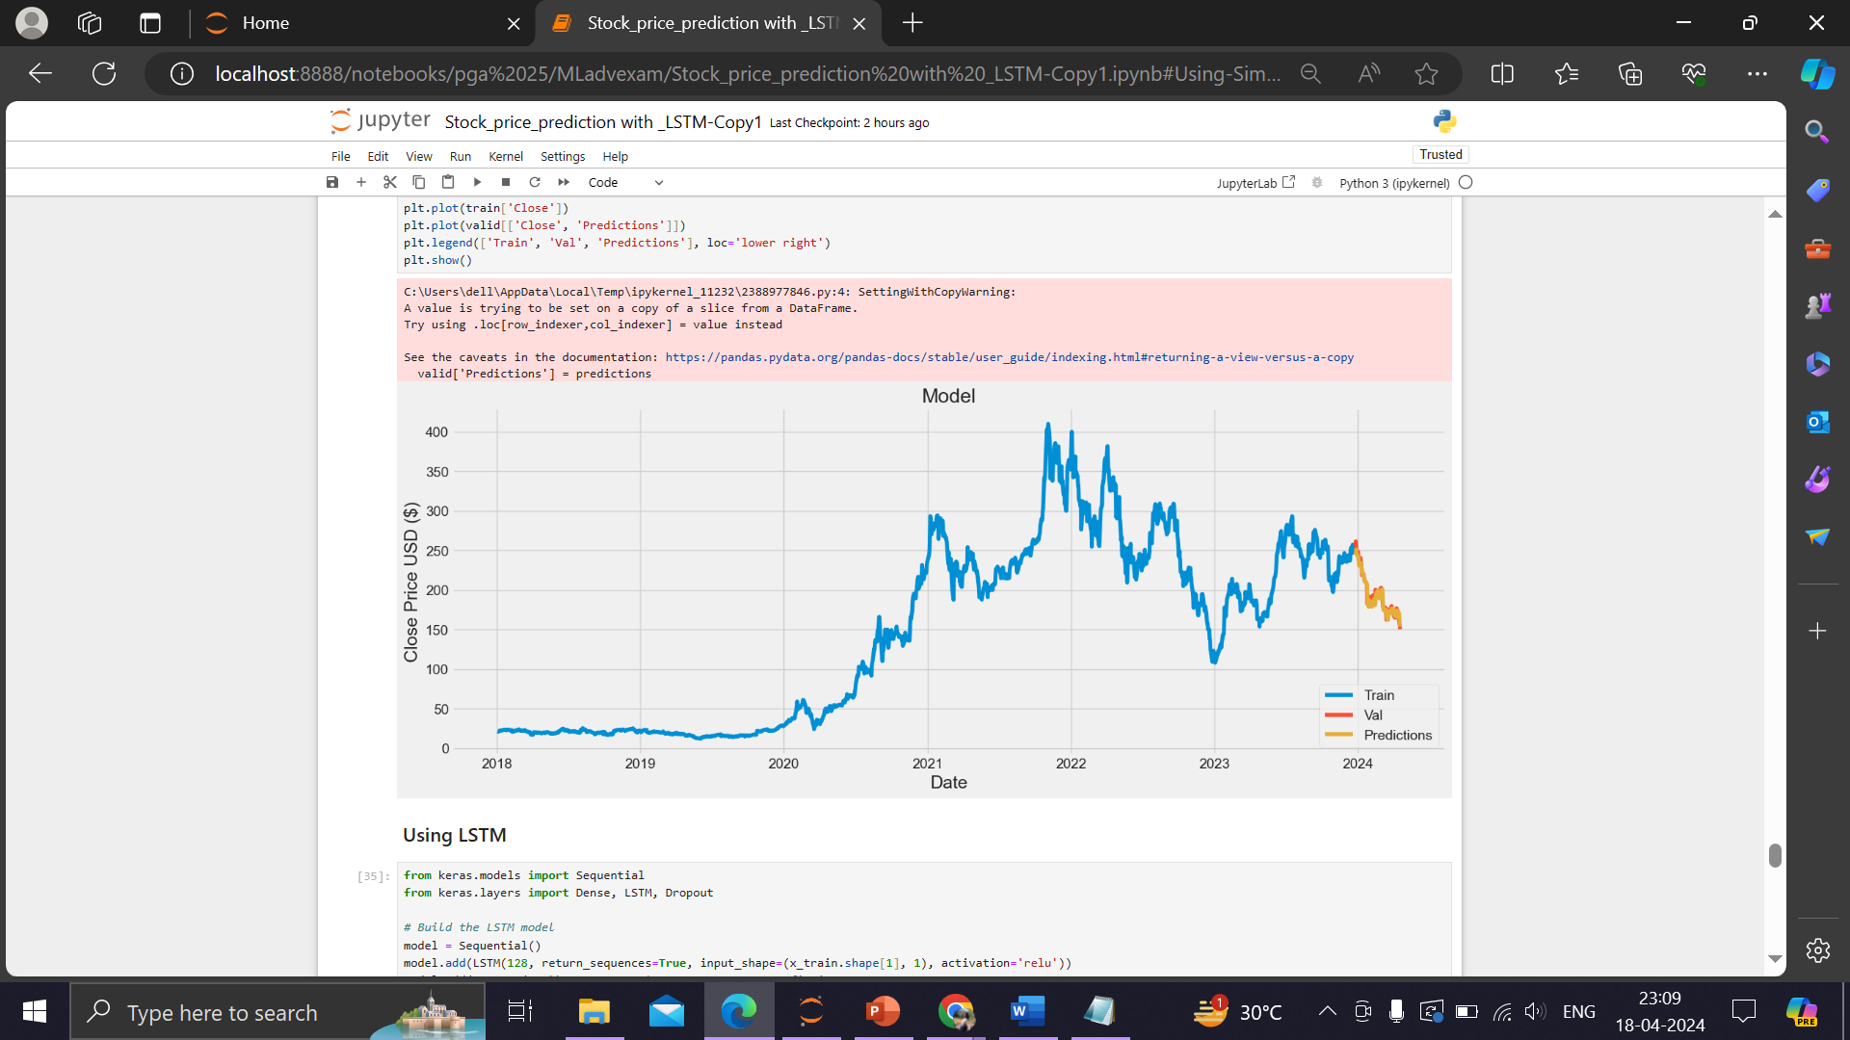
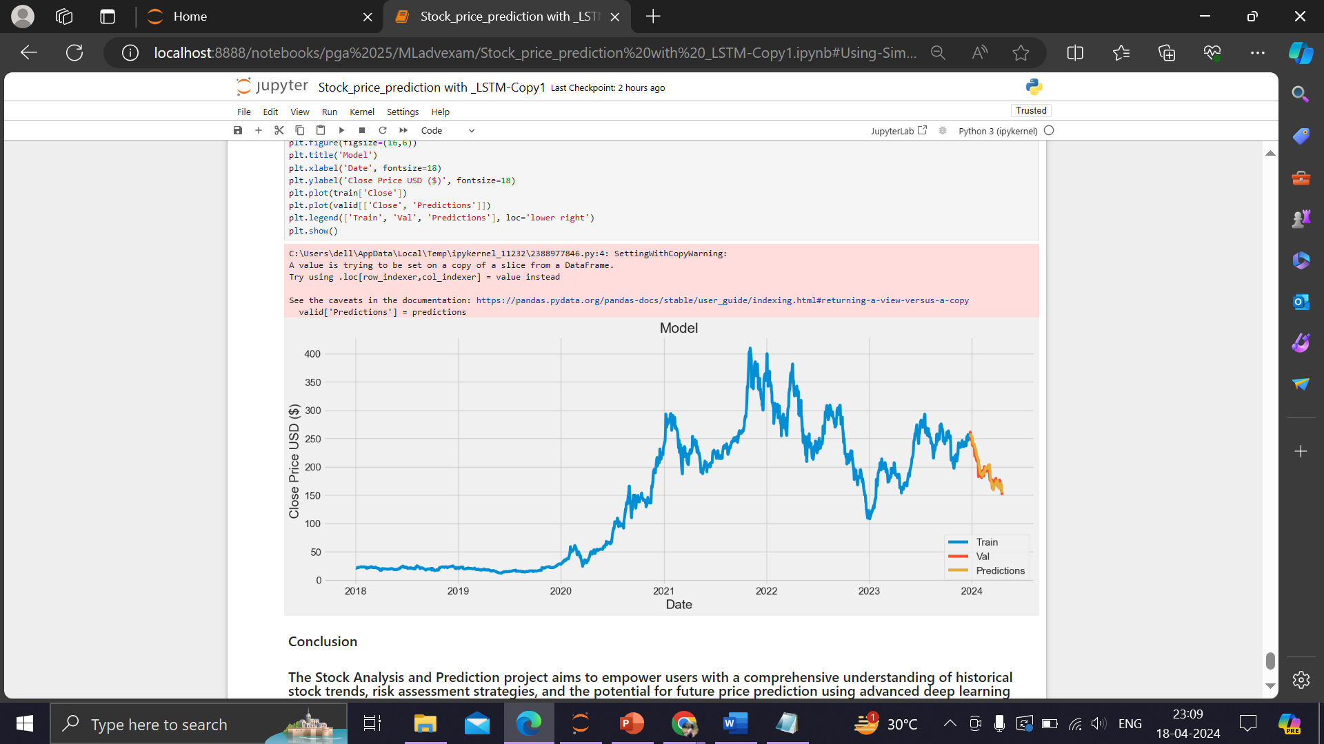
Simple RNN
LSTM

Slide 19

Conclusion
8

Slide 20
Upon comparing the two models, it becomes evident that LSTM outperforms Simple RNN since it has a lower RMSE value.

Slide 21

This project is made to help individuals make better decisions while investing in Mutual Funds as per their own risk appetite and also the ratings provided for each schemes to make informed decisions. The dashboards/reports created using the Visualization tool gives us a better understanding of the Mutual Fund Industry in India

